Slide 1

String Methods Practice

Slide 2
Reference
Chapter 14 (O'Reilly) of Hands-On ML
aneesh joshi’s Blog, Code, and related Jupyter_Notebook
Youtube
Code

Slide 3
String Methods

Slide 4
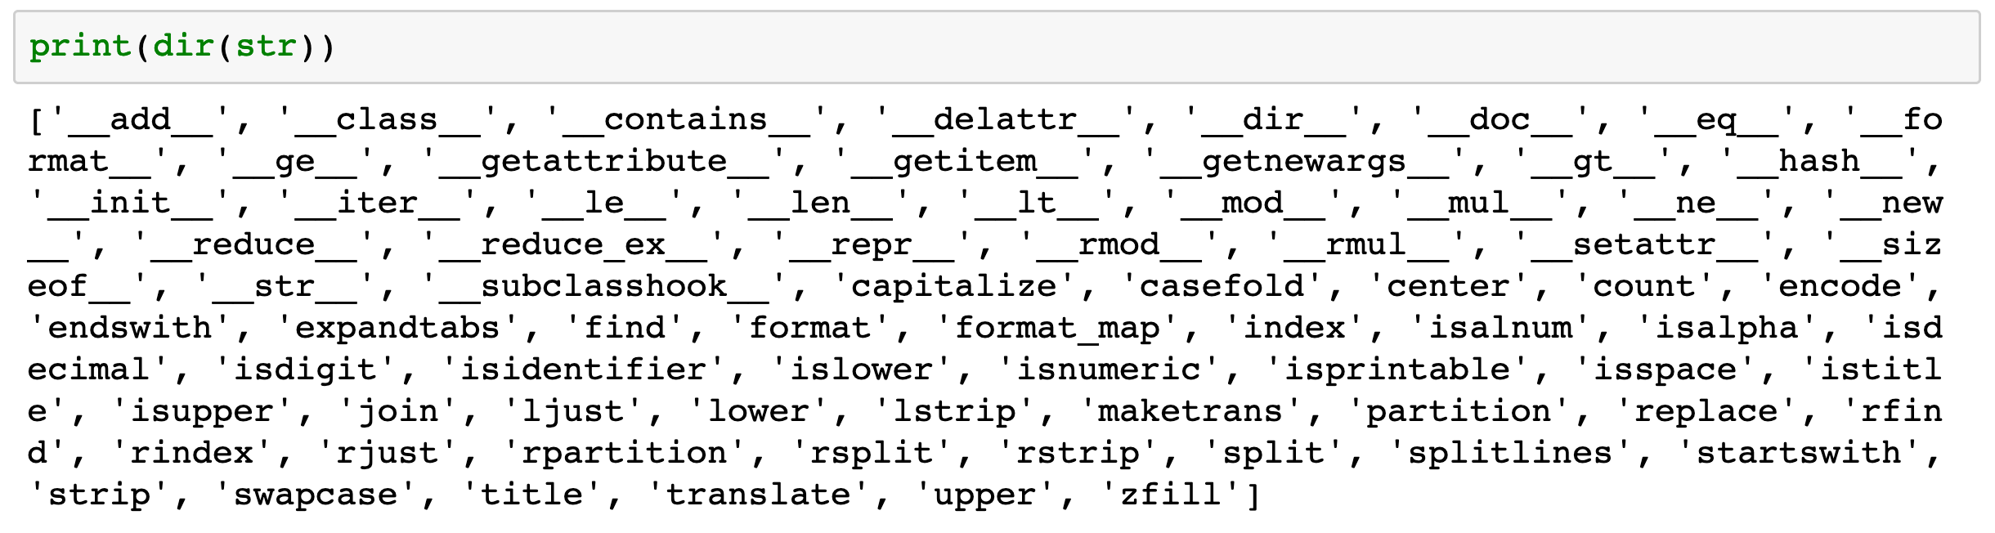

Slide 5
Data

Slide 6
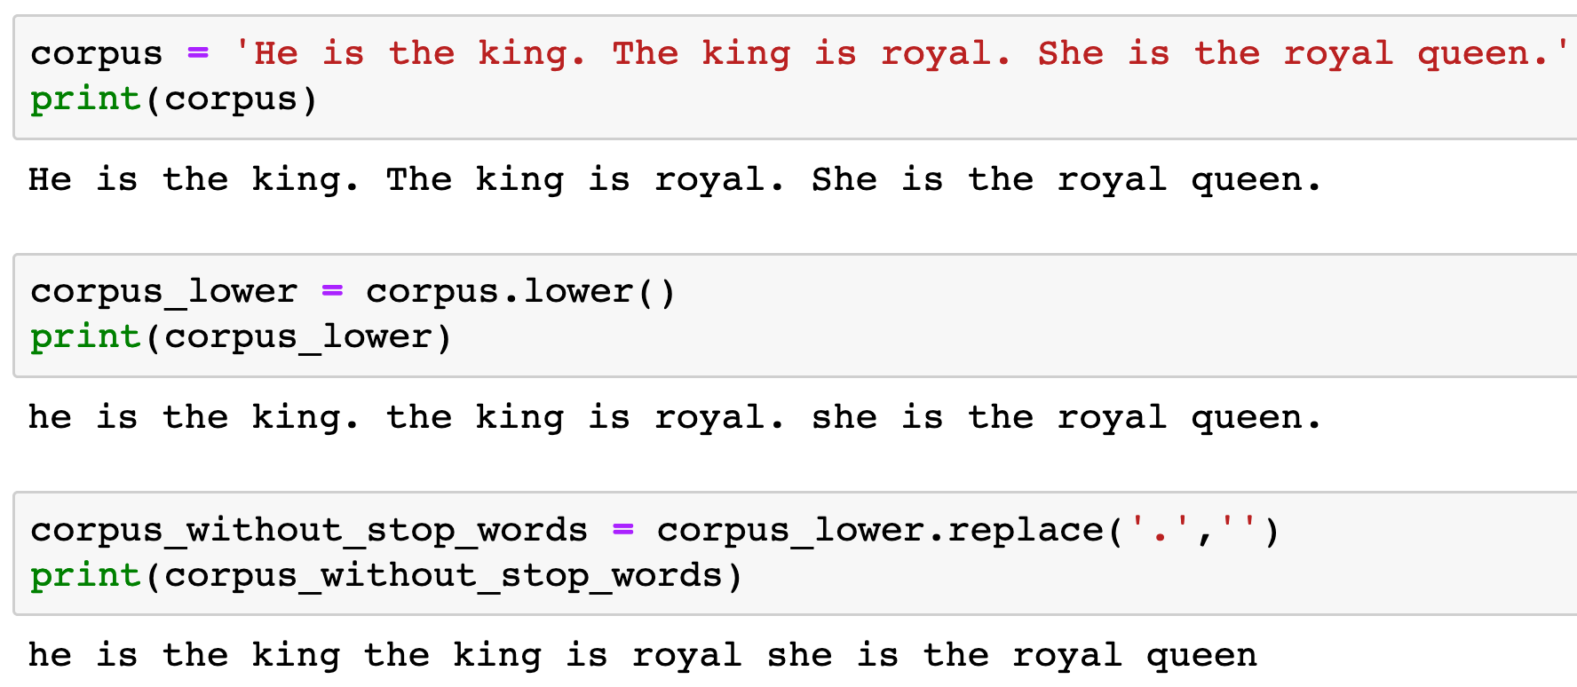


Slide 9
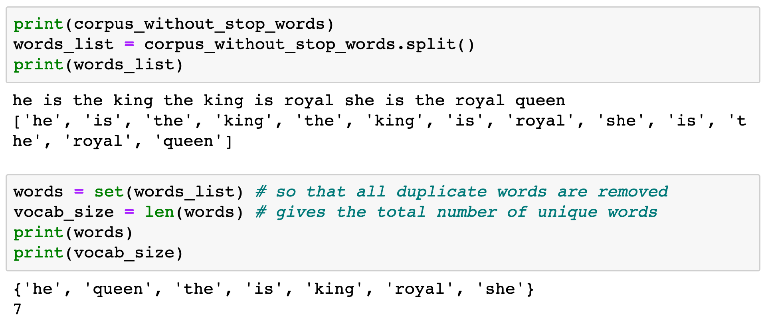


Slide 11
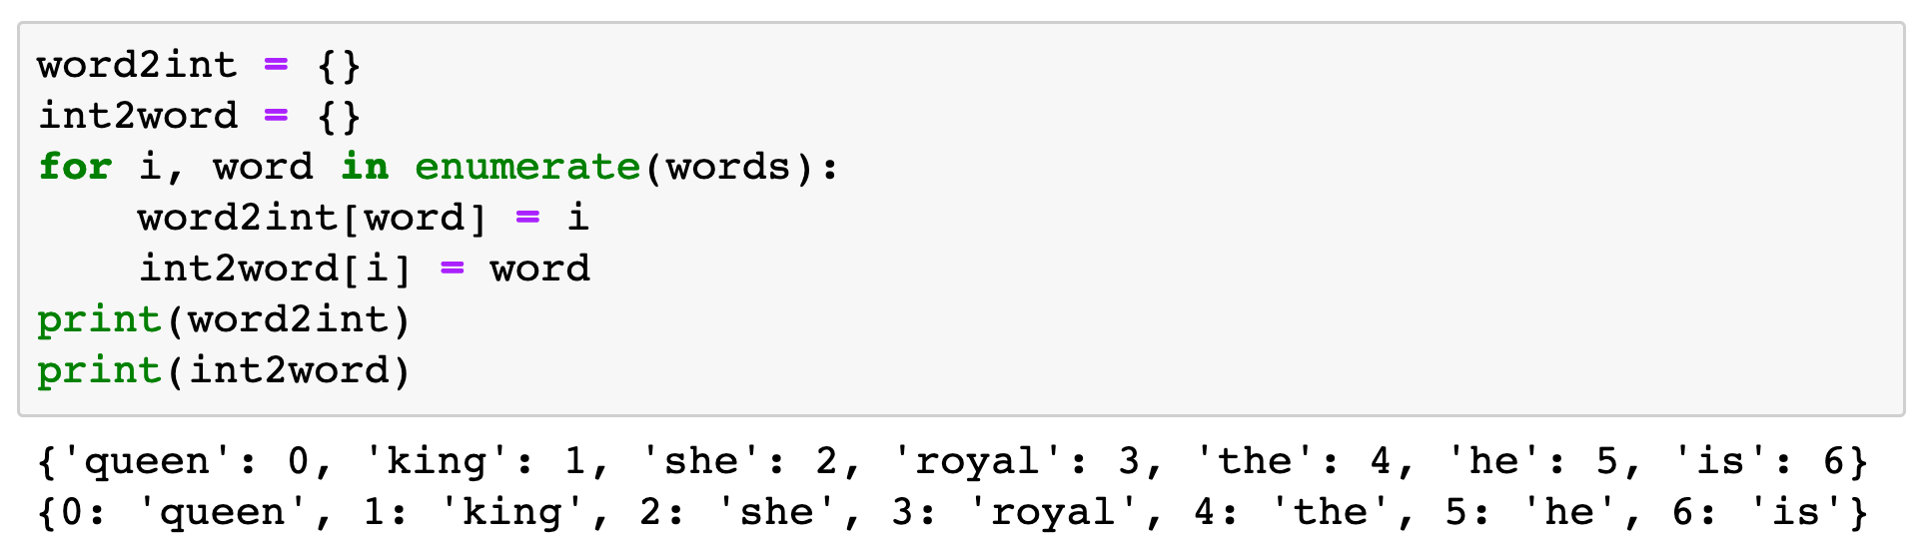

Slide 12
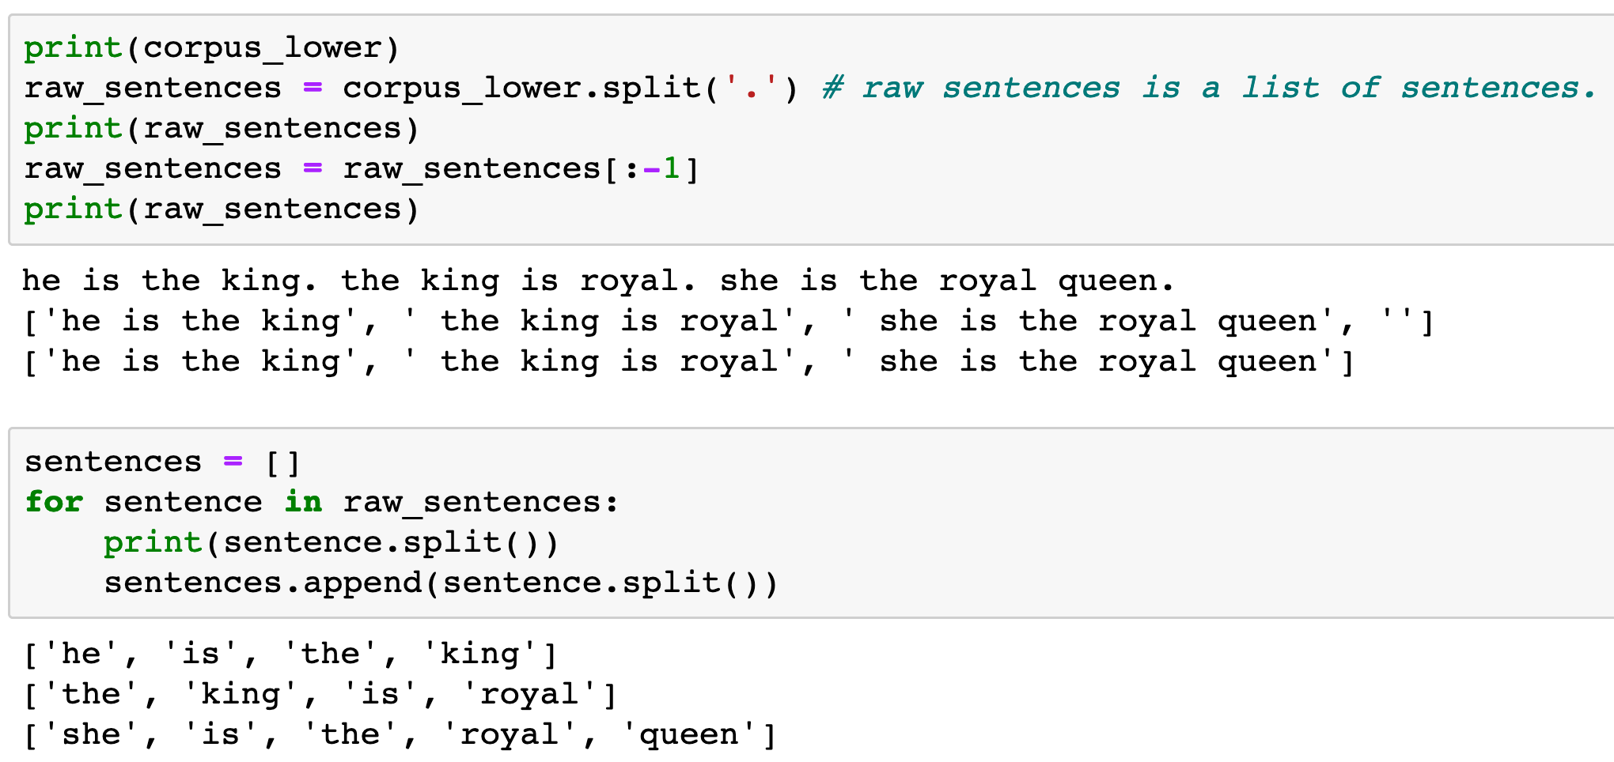

Slide 14
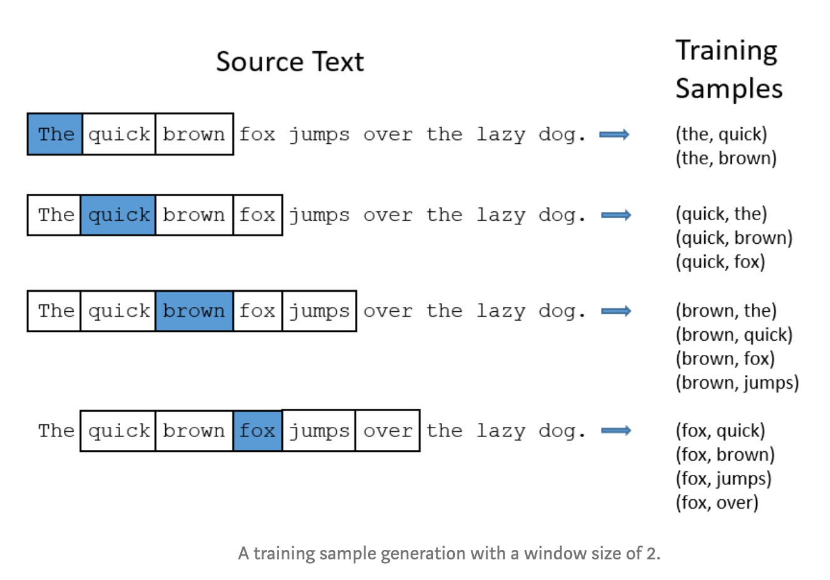
aneesh joshi’s Blog

Slide 15
aneesh joshi’s Blog
target word

Slide 16
aneesh joshi’s Blog
target word
context word

Slide 17
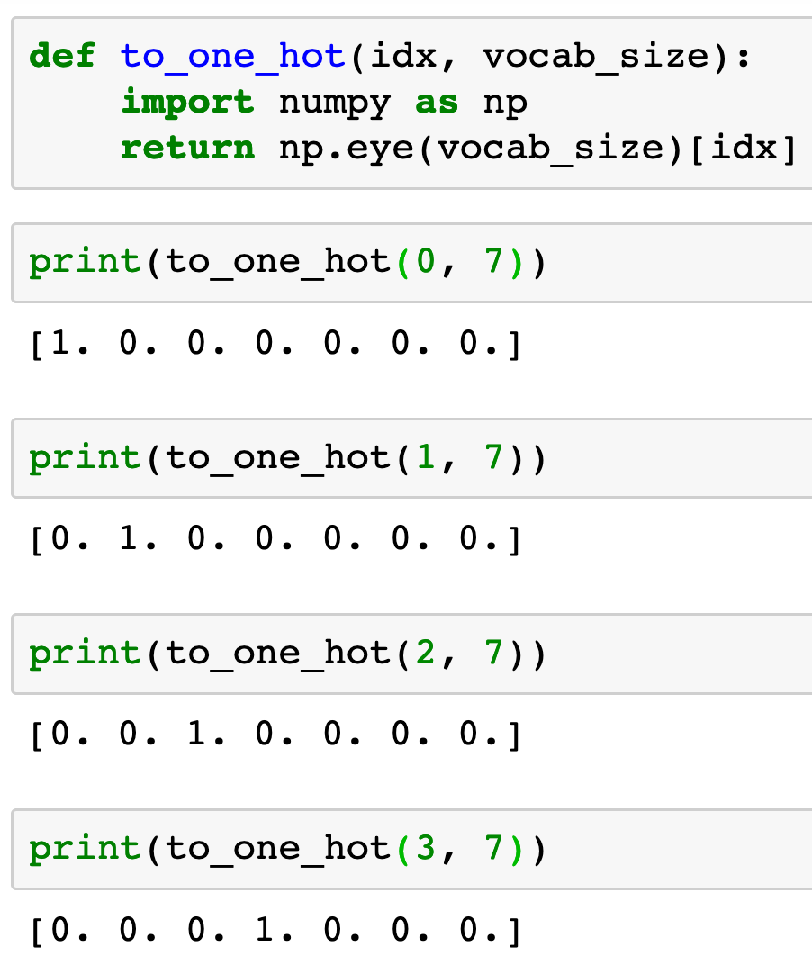


Slide 22
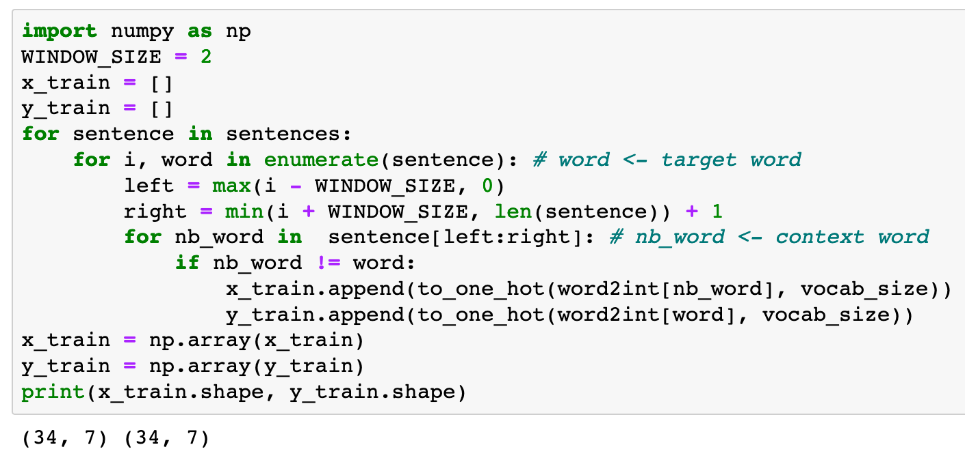

Slide 23
Now
Let’s Play with Code

